Slide 1




ANALYZING DIABETES DATASET
1

Slide 2
MEMBERS
Doha Hemdan 202200701
Galal Qasas 202201379
Ibrahem Ali 202201987
Salma Sherif 202200622
Ziad Moutaz 202201252

Slide 3

OUTLINE
Introduction
1
Data Processing and Analysis Steps
2
Challenges, Limitations, and Assumptions
3
4
Results and Visualizations
Answering Questions
5
3

Slide 4
EXPLORATORY ANALYSIS
4

Slide 5
PREPROCESSING
REMOVE NULL VALUES
we checked the values in each column. We found some columns have 0 values which is not biologically possible. we imputed them
REMOVE OUTLIERS
Outliers influence our statistical analysis leading to skewness and bias in our results. Removing them guarantees that our analysis is robust and reliable.
5

Slide 6
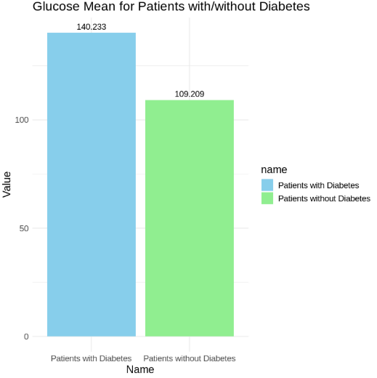
THE AVERAGE GLUCOSE LEVELS AMONG PATIENTS WITH AND WITHOUT DIABETES
Diabetic Patients have higher Glucose Values.
6

Slide 7
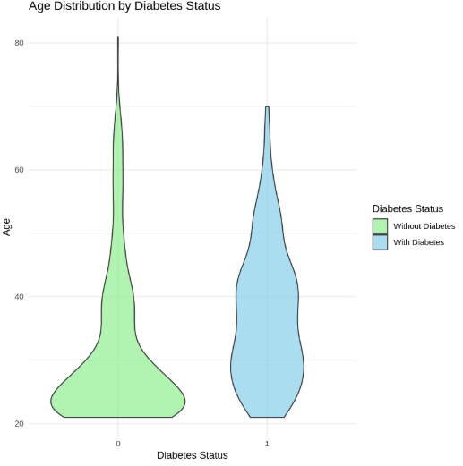
THE AVERAGE AGE OF PATIENTS WITH AND WITHOUT DIABETES.
Patients with higher ages tends to be more diabetic.
7

Slide 8
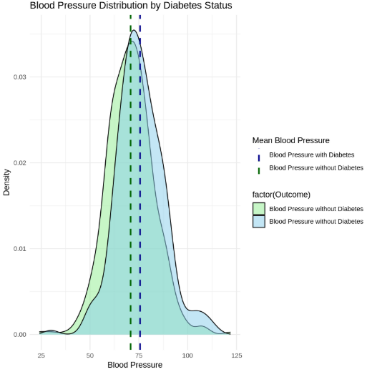
THE AVERAGE BLOOD PRESSURE MEASUREMENTS ACROSS DIABETIC AND NON-DIABETIC GROUPS.
Blood Preassure Density nearly same in both types of patients.
8

Slide 9
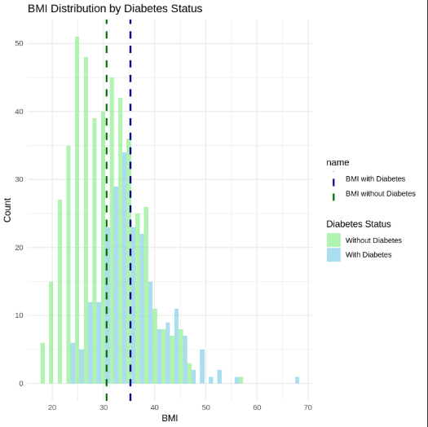
THE AVERAGE BMI OF DIABETIC VERSUS NON-DIABETIC PATIENTS.
BMI of Diabetic patients has higher variance due to outliers.
9

Slide 10
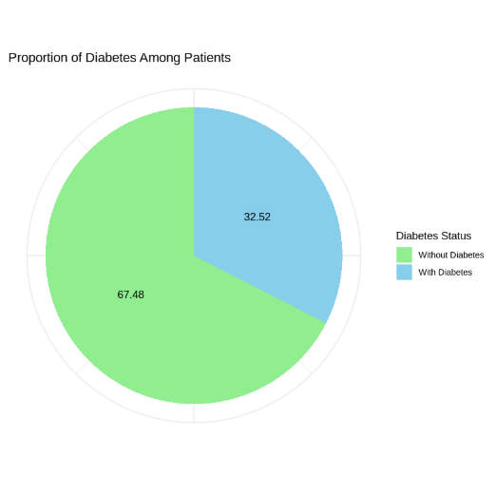
THE RATE OF DIABETES AMONG PATIENTS IN THE DATASET.
Rate of Diabetes in the dataset is 32%.
10

Slide 11
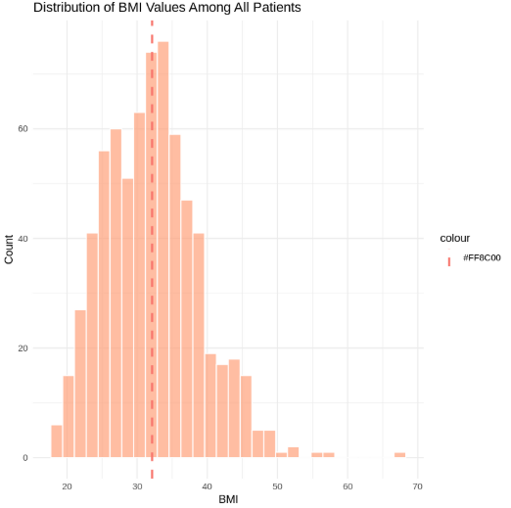
THE DISTRIBUTION OF BMI VALUES AMONG ALL PATIENTS.
Average BMI of all Patients is higher than the average BMI of Non-diabetic patients and lower that diabetic patients.
11

Slide 12
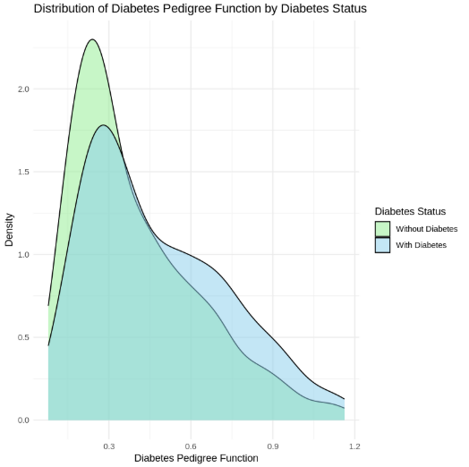
THE DISTRIBUTION OF DIABETES PEDIGREE FUNCTION (DPF) VALUES FOR DIABETIC AND NON-DIABETIC PATIENTS.
Diabetic patients show significantly higher blood pressure than non-diabetic individuals.
12

Slide 13
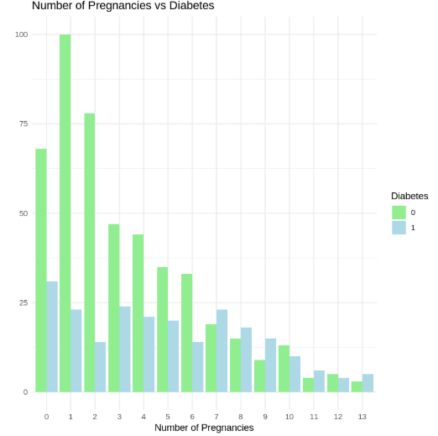
THE RELATIONSHIP BETWEEN THE NUMBER OF PREGNANCIES AND DIABETES OCCURRENCE.
People with diabetes tend to have higher BMI values overall.
13

Slide 14
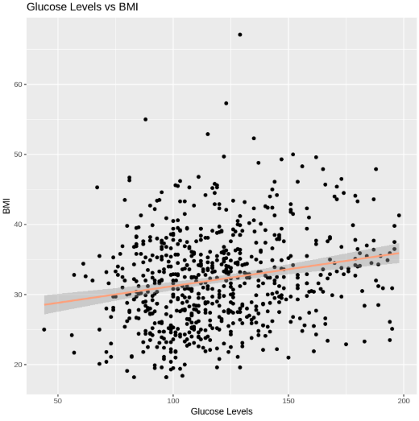
THE CORRELATION BETWEEN GLUCOSE LEVELS
AND BMI.
Glucose and BMI nearly have no correlation of value nearly 0.2.
14

Slide 15
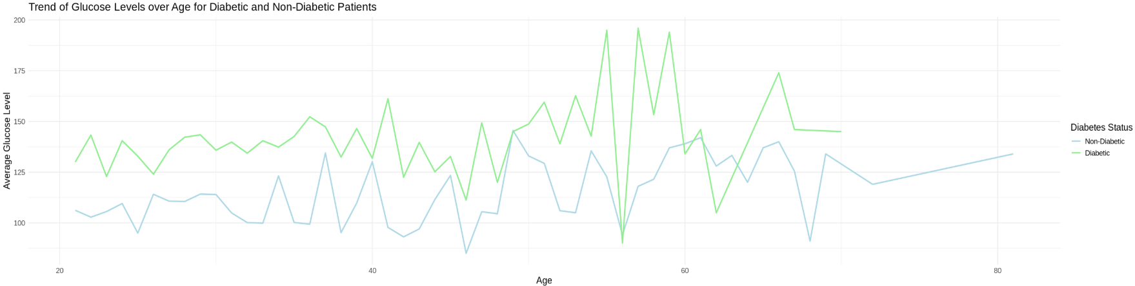
THE TREND OF GLUCOSE LEVELS WITH AGE AMONG DIABETIC AND NON-DIABETIC PATIENTS.
Diabetic patients show higher, more variable glucose levels, especially during older age.
15

Slide 16
ANSWERING QUESTIONS
PART 1
16

Slide 17
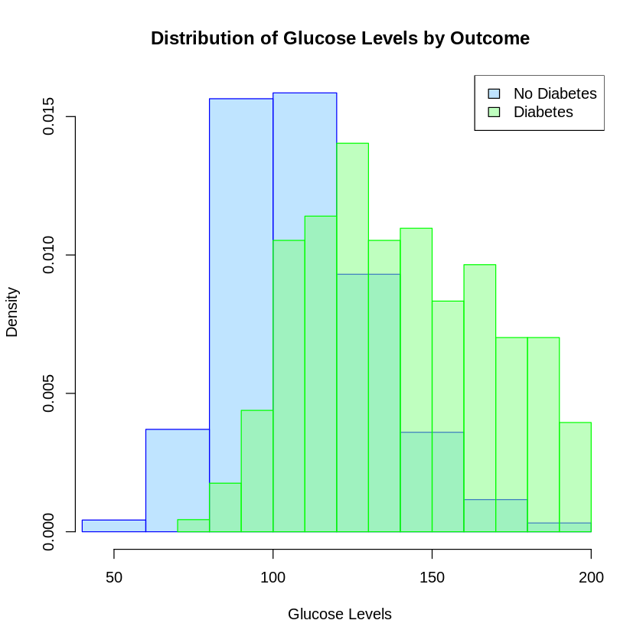
ARE HIGHER GLUCOSE LEVELS ASSOCIATED WITH A GREATER LIKELIHOOD OF DIABETES?
Higher glucose levels are more strongly associated with diabetes.
17

Slide 18
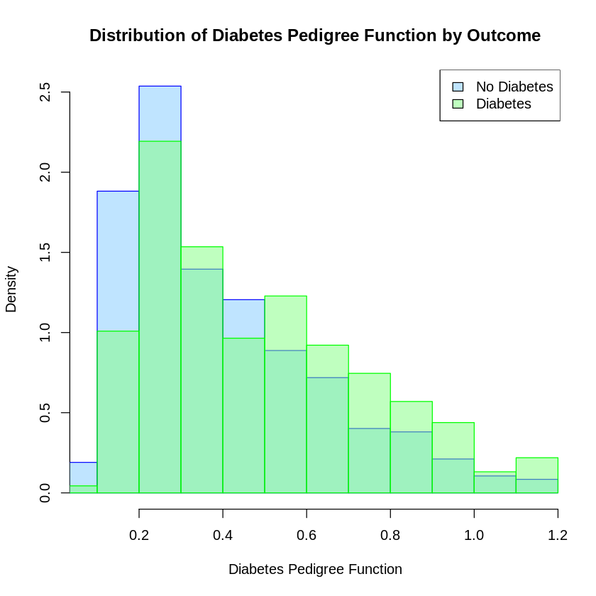
ARE HIGHER GLUCOSE LEVELS ASSOCIATED WITH A GREATER LIKELIHOOD OF DIABETES?
Higher Diabetes Pedigree Function values are associated with a greater likelihood of diabetes.
18

Slide 19
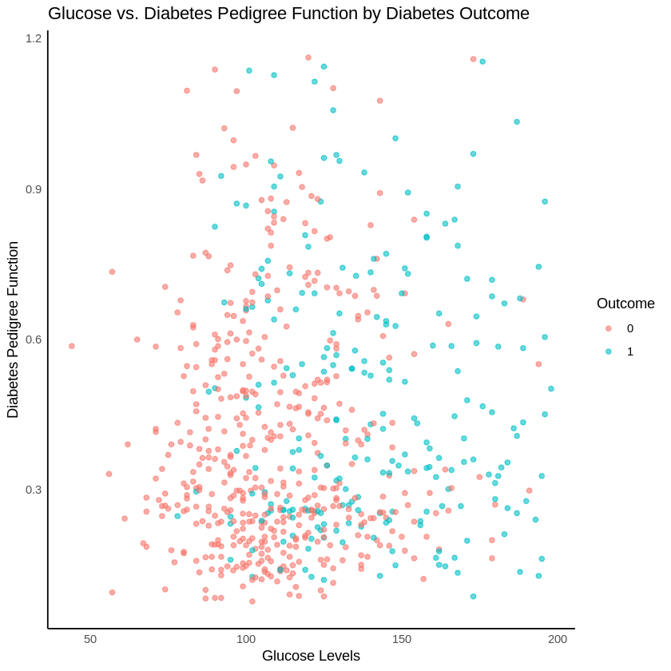
ARE HIGHER GLUCOSE LEVELS ASSOCIATED WITH A GREATER LIKELIHOOD OF DIABETES?
Preforming Pearson's product-moment correlation:
CORRELATION COEFFICIENT
The correlation coefficient is 0.061, indicating a very weak positive correlation.
P-VALUE
The p-value is greater than 0.05, this means we fail to reject the null hypothesis.
T-STATISTIC
The value is small 1.62, suggesting weak evidence.
CONCLUSION
There is insufficient evidence to conclude that higher glucose levels are strongly associated with a greater likelihood of diabetes
19

Slide 20
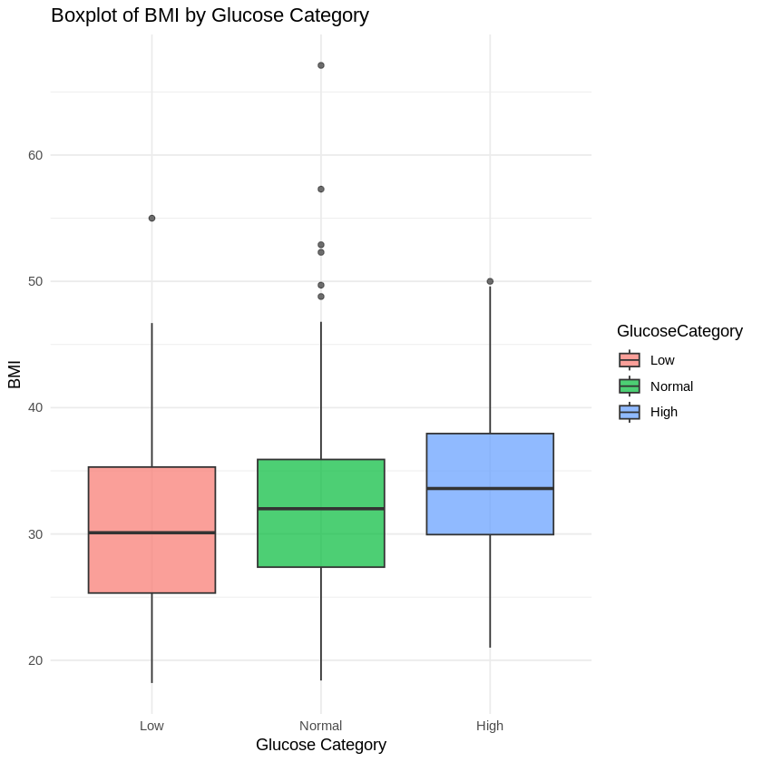
ARE PATIENTS WITH HIGH GLUCOSE CONCENTRATIONS ALSO LIKELY TO HAVE HIGHER BMI VALUES?
It appears that there is a slight association between higher glucose levels with higher BMI values.
20

Slide 21
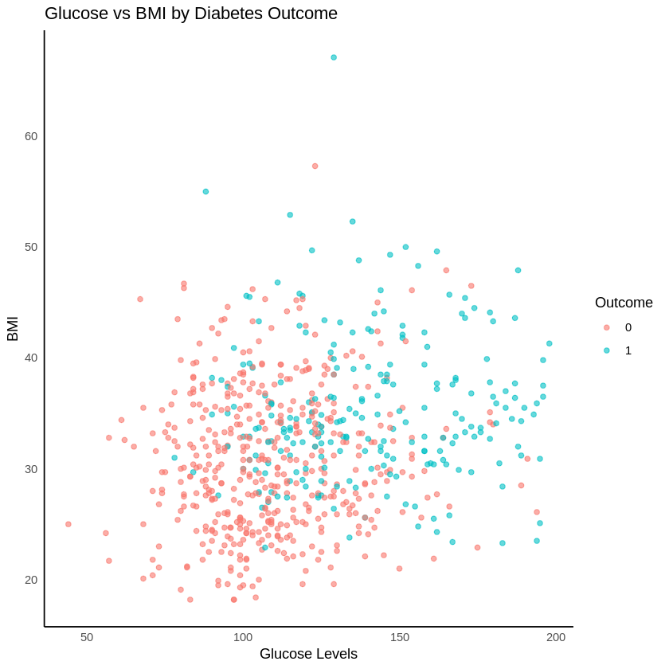
ARE PATIENTS WITH HIGH GLUCOSE CONCENTRATIONS ALSO LIKELY TO HAVE HIGHER BMI VALUES?
Preforming Pearson's product-moment correlation:
CORRELATION COEFFICIENT
The correlation coefficient is 0.2059253. This indicates a weak positive correlation
P-VALUE
The p-value is smaller than 0.05, so we can confidently reject the null hypothesis that there is no correlation.
T-STATISTIC
The value is large 5.5636, quantifies the strength of evidence against the null hypothesis
CONCLUSION
There is a statistically significant but weak positive correlation between Glucose levels and BMI.
21

Slide 22
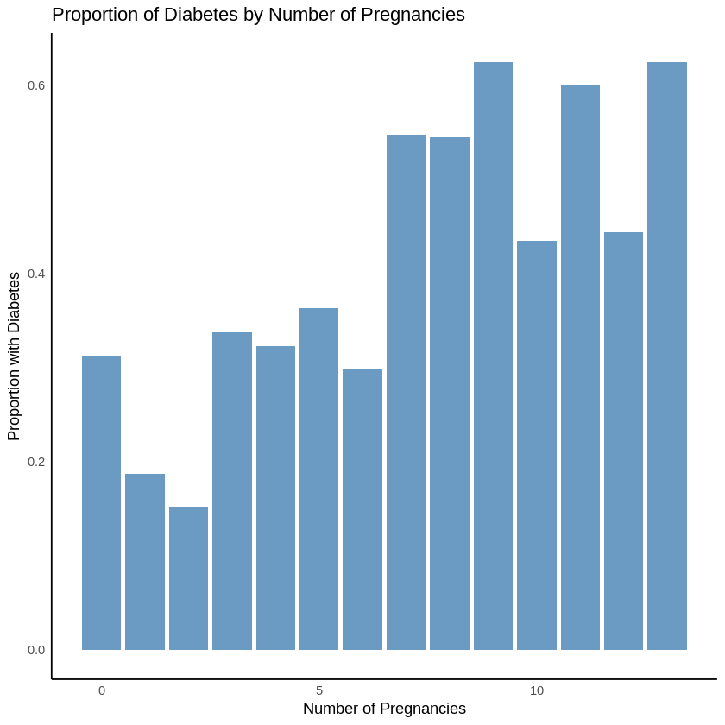
ARE PATIENTS WITH A HIGHER NUMBER OF PREGNANCIES AT GREATER RISK OF DEVELOPING DIABETES?
The proportion of patients with diabetes tends to increase as the number of pregnancies increases.
22

Slide 23
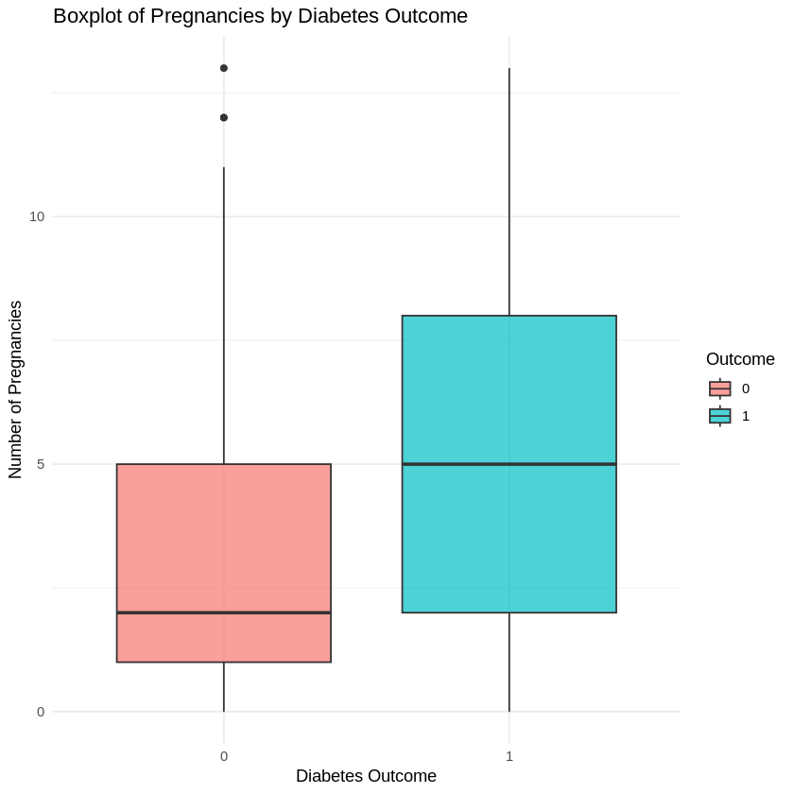
ARE PATIENTS WITH A HIGHER NUMBER OF PREGNANCIES AT GREATER RISK OF DEVELOPING DIABETES?
Preforming Pearson's product-moment correlation:
CORRELATION COEFFICIENT
The correlation coefficient is 0.2287. This indicates a weak positive correlation
P-VALUE
The p-value is extremely smaller than 0.05, so we can confidently reject the null hypothesis that there is no correlation.
T-STATISTIC
The value is large 6.2102 which supports the conclusion that the relationship is statistically significant.
CONCLUSION
There is a statistically significant but weak positive correlation between the number of pregnancies and the Outcome variable.
23

Slide 24
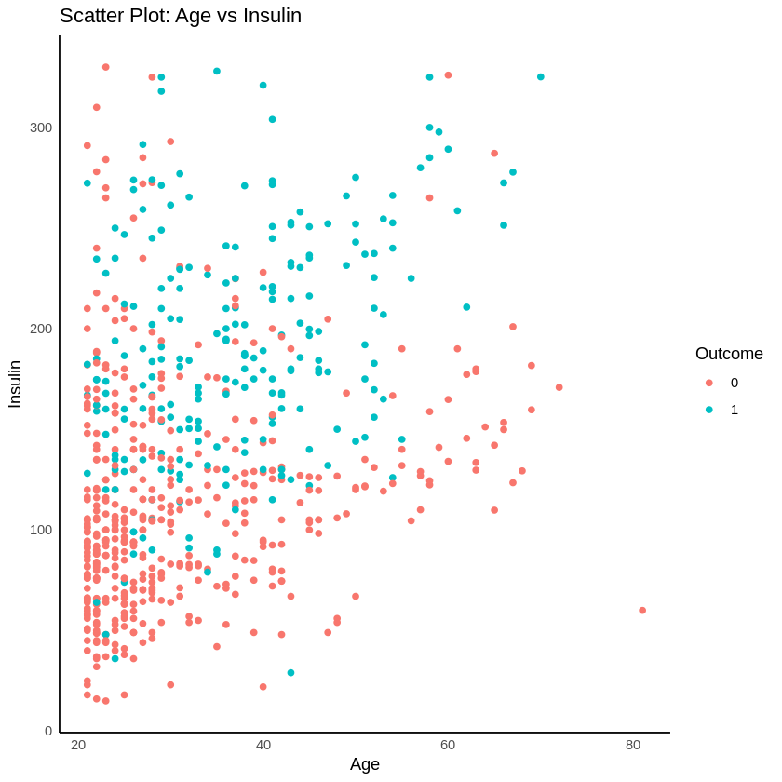
ARE OLDER PATIENTS MORE LIKELY TO HAVE HIGHER INSULIN CONCENTRATIONS AND BLOOD GLUCOSE LEVELS?
Linear Regression for Insulin and age
Insulin = 75.2560 + 1.9204 × Age
There is a positive and statistically significant relationship between age and insulin levels. For each additional year of age, insulin levels are expected to increase by approximately 1.92 units.
The R-squared value of 11.5% suggests that age alone does not explain a large proportion of the variation in insulin levels.
24

Slide 25
ARE OLDER PATIENTS MORE LIKELY TO HAVE HIGHER INSULIN CONCENTRATIONS AND BLOOD GLUCOSE LEVELS?
Linear Regression for Glucose and age
Glucose = 95.77412 + 0.71061 × Age
There is a significant positive relationship between age and glucose levels, as indicated by the p-value (< 0.05).
The R-squared value of 0.08208 means that only 8.21% of the variance in glucose levels is explained by age.
25

Slide 26
ARE OLDER PATIENTS MORE LIKELY TO HAVE HIGHER INSULIN CONCENTRATIONS AND BLOOD GLUCOSE LEVELS?
Conclusion
Older patients are more likely to have higher insulin concentrations and glucose levels, based on the positive correlations identified in the regression models.
The relationships are weak, meaning age alone does not account for much of the variability in insulin or glucose levels. Other factors play a larger role.
26

Slide 27
WHAT IS RISK PROFILE?
A risk profile refers to the identification and assessment of potential risks associated with an individual, group, or population. It is a comprehensive summary of characteristics, behaviors, or conditions that could make a person or group more vulnerable to certain risks, especially in health or finance.
27

Slide 28
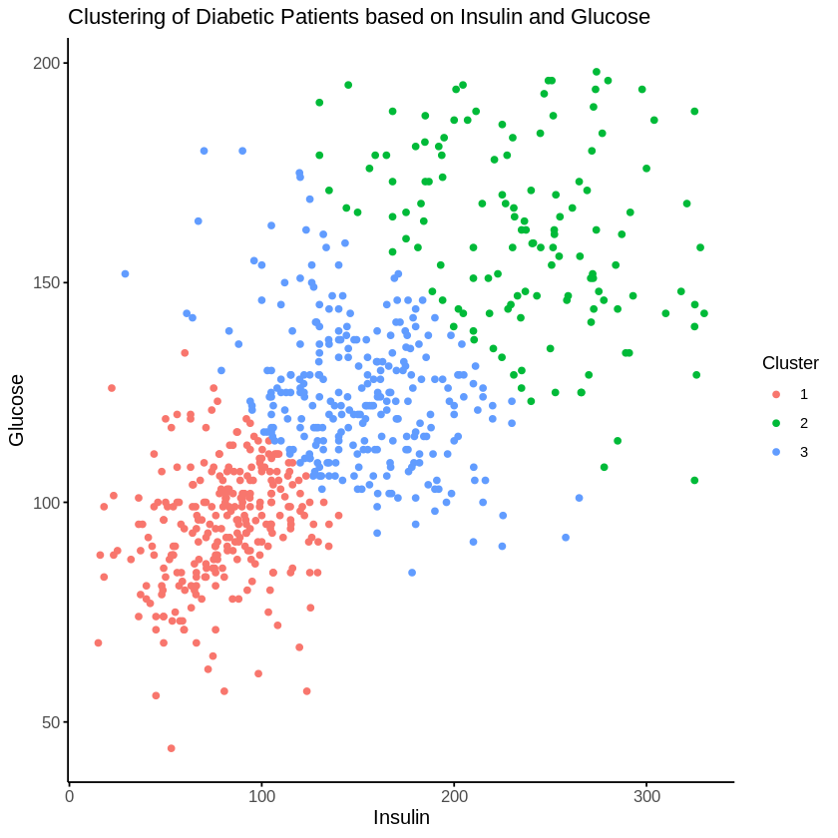
CAN YOU IDENTIFY COMMON “RISK PROFILES” FOR DIABETIC PATIENTS BASED ON KEY METRICS GLUCOSE AND INSULIN ?
PREPARE DATA FOR CLUSTERING BY:
Selecting relevant variables.
Do standardizing.
Assign new cluster col to the data.
28

Slide 29
CAN YOU IDENTIFY COMMON “RISK PROFILES” FOR DIABETIC PATIENTS BASED ON KEY METRICS GLUCOSE AND INSULIN?
CONCLUSION
The clustering analysis based on insulin and glucose levels reveals three distinct groups of diabetic patients:
Cluster 1 (Red): This group is characterized by relatively low insulin and glucose levels. These patients likely represent individuals with milder insulin resistance or better controlled diabetes.
Cluster 2 (Green): This group has high insulin and glucose levels. These individuals may have more severe insulin resistance or poorly controlled diabetes.
Cluster 3 (Blue): This group falls between clusters 1 and 2, with moderate insulin and glucose levels. These patients may represent those with intermediate risk or diabetes management outcomes.
29

Slide 30
Bivariate/Multivariate Analysis
30

Slide 31
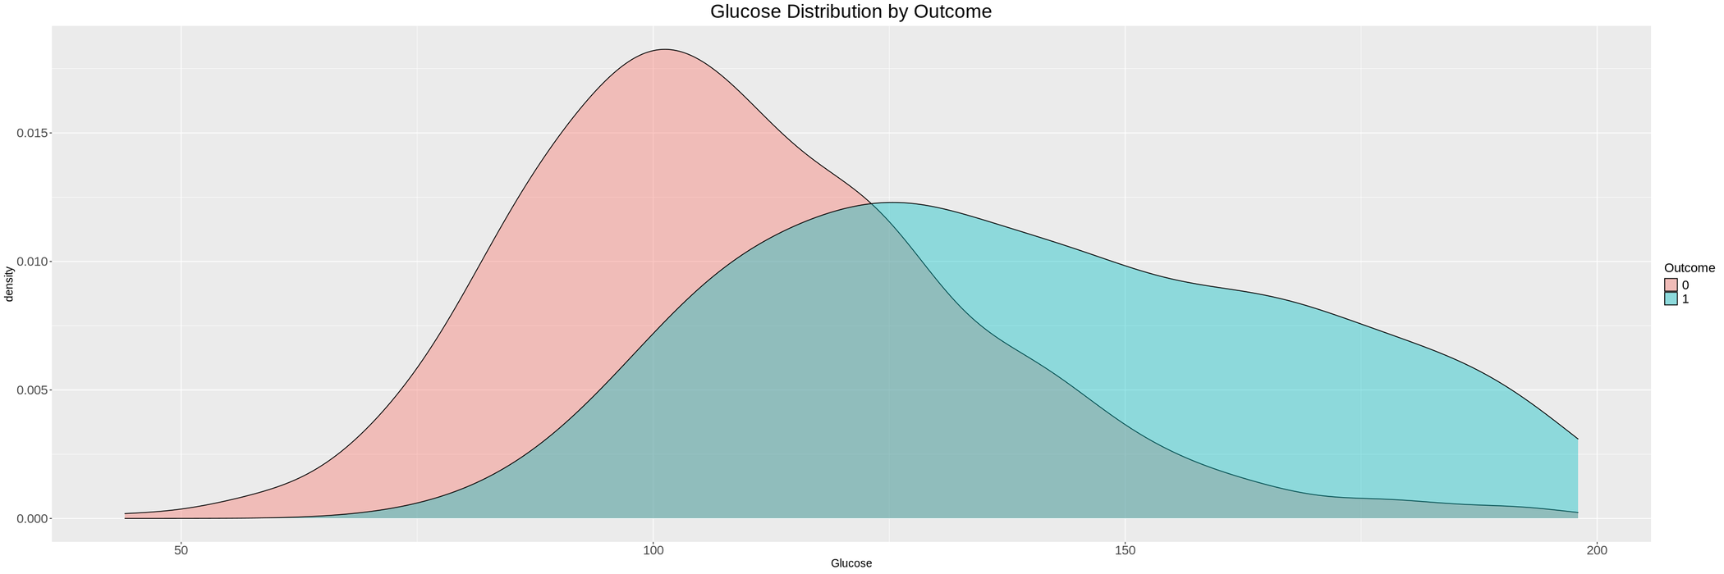
Glucose Distribution by Outcome
The red curve (for people with diabetes) skews higher. This indicates glucose level among diagnosed individuals is noticeably higher. We can see that the red curve is dense at lower Glucose levels, while blue curve is is dense at higher Glucose levels and has a wider spread.
31

Slide 32
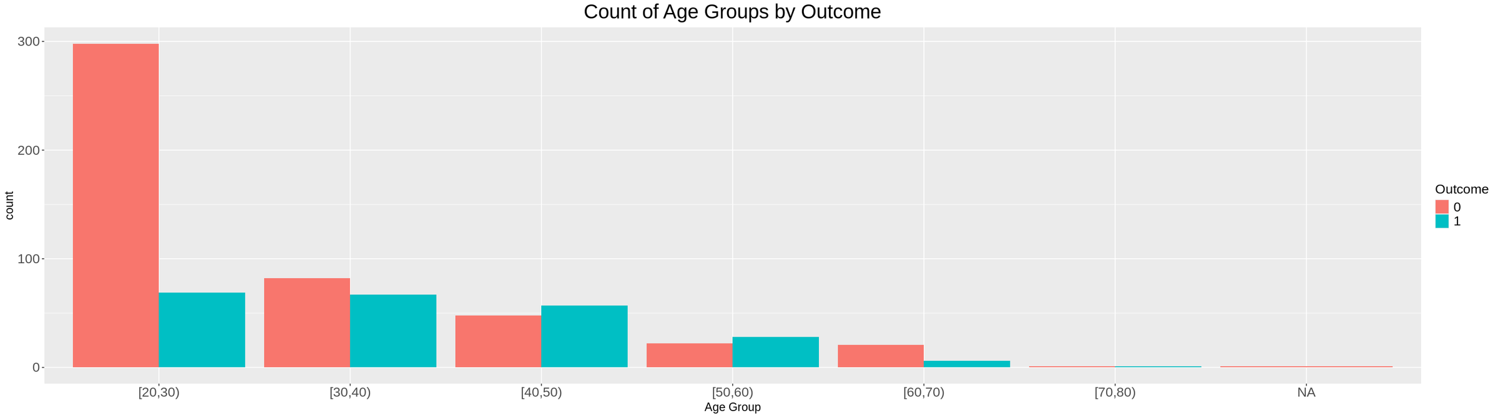
Count of Age Groups by Outcome
This bar chart shows the count of individuals in different age groups, categorized by Outcome (0 or 1). The 20-30 age group has the most significant difference.
32

Slide 33
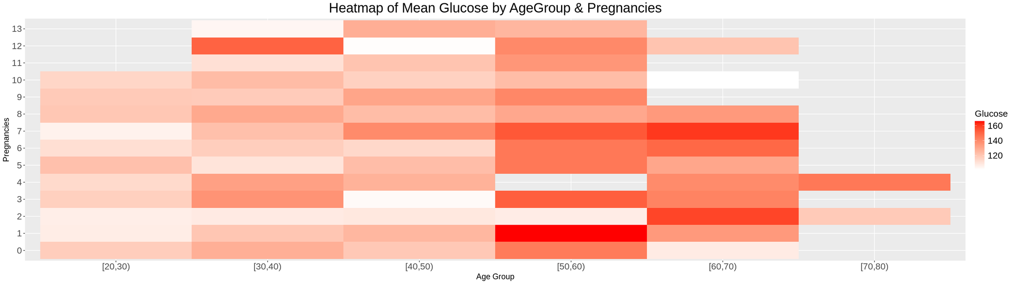
Mean Glucose by Age Group & Pregnancies
This heatmap visualizes the average Glucose levels across different age groups and pregnancy counts.
We notice that:
The highest mean Glucose levels are observed in the 50-60 age group with 1 pregnancy and the 30-40 age group with 12 pregnancies.
Generally, Glucose levels appear to increase with age for a given number of pregnancies.
33

Slide 34
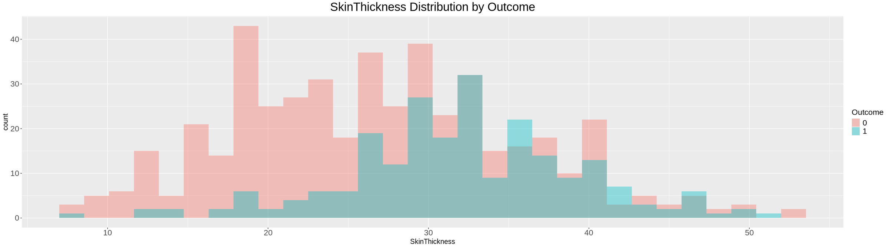
Skin Thickness Distribution by Outcome
This histogram shows the distribution of SkinThickness for people with diabetes and people without. The graph shows that people with diabetes tend to have higher SkinThickness values.
34

Slide 35
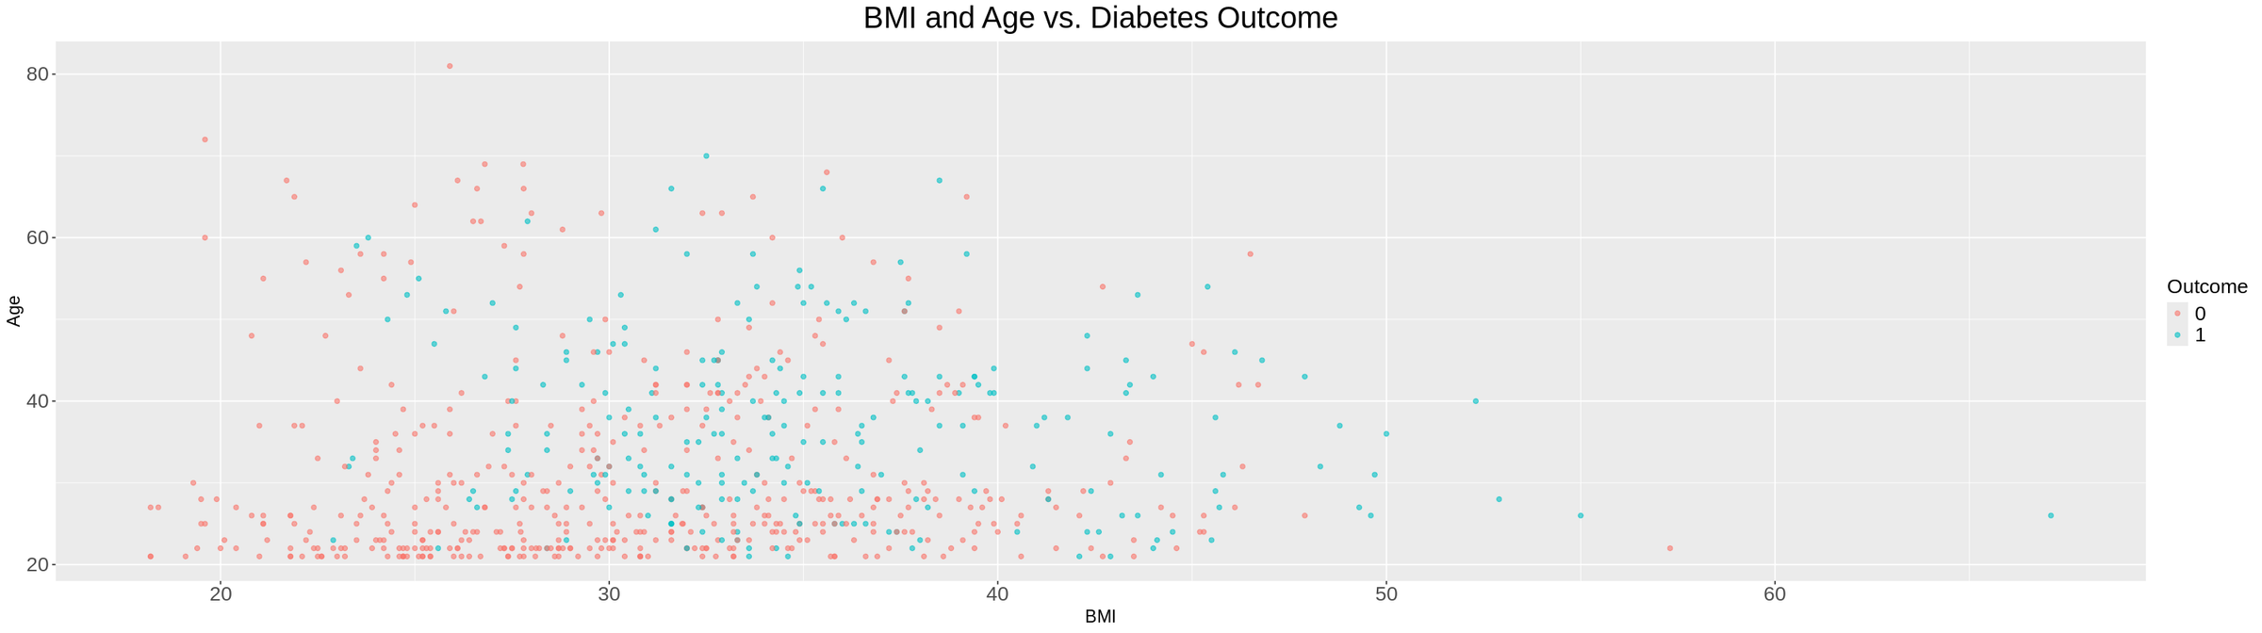
BMI and Age vs. Diabetes Outcome
Individuals with diabetes generally have higher BMI and are older than those without. This suggests higher BMI and older age may be associated with increased diabetes risk.
35

Slide 36
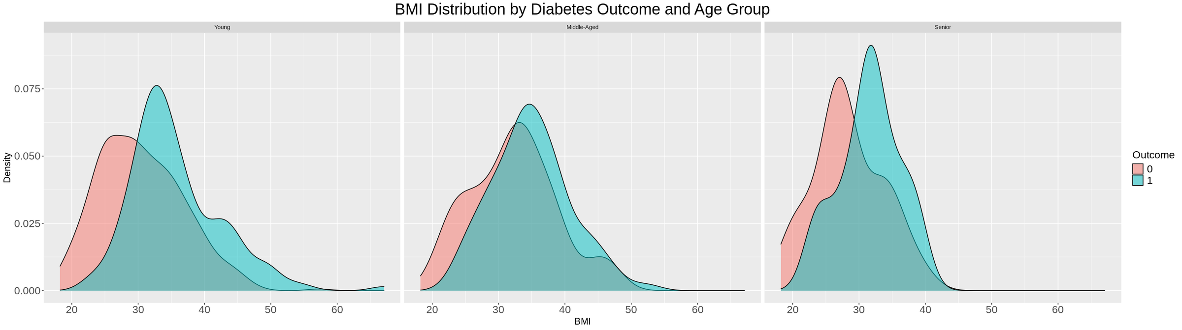
BMI Distribution by Diabetes Outcome and Age Group
The BMI distribution differs between outcome groups. Individuals with diabetes tend to have higher BMI in these age groups. In the "Senior" group, the difference is less pronounced.
36

Slide 37
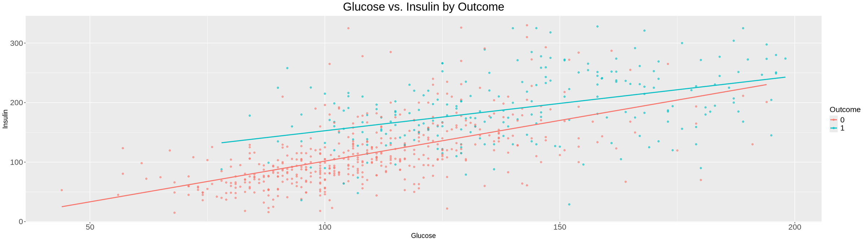
Glucose vs. Insulin
This scatter plot shows the relationship between Glucose and Insulin, with trend lines. People with diabetes show a smoother positive relationship between Glucose and Insulin compared to people without.
37

Slide 38
HYPOTHESIS TESTING
38

Slide 39
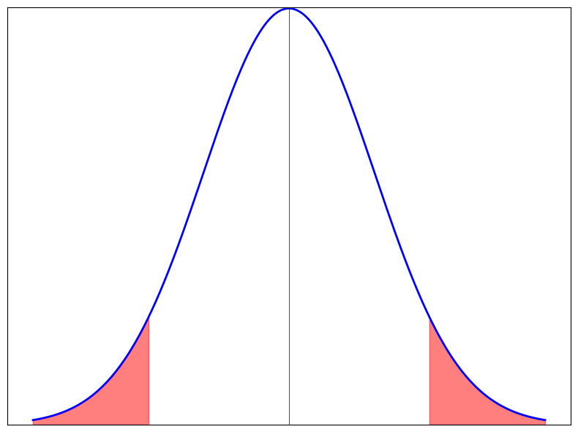
CLAIM 1
Is there is any significant difference in glucose values between the diabetic and nondiabetic patients?
A t test with significance value 0.05 to test the hypothesis.
We measured the P-Value, and we found that it is less than the significance value, which leads us to reject the null hypothesis.
39

Slide 40
STATISTICAL SUMMARY
Standard Error: 2.18569
CI for the mean: [26.72725, 35.32242]
Mean Estimation of diabetic patients: 140.2334
Mean Estimation of Non-diabetic patients: 109.2086
40

Slide 41
CONCLUSION
Since the p-value is less than the significance value, there is a significant difference between glucose levels between diabetic and non-diabetic patients.
41

Slide 42
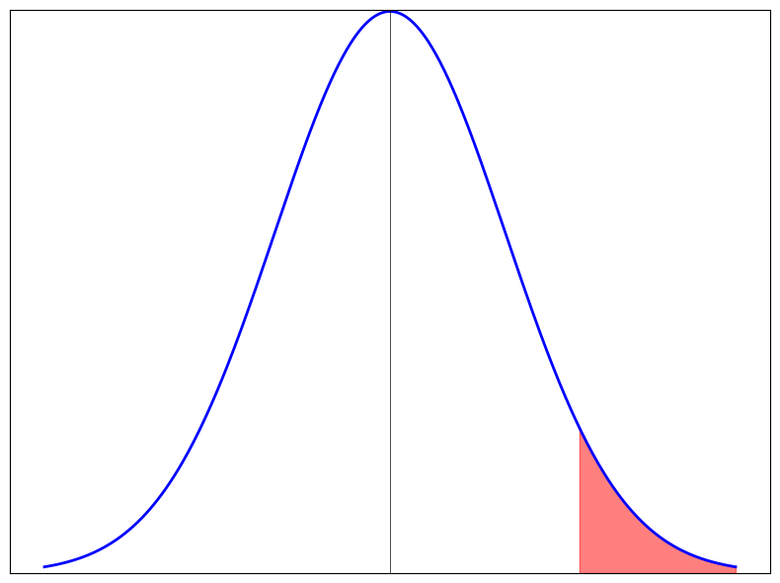
CLAIM 2
Is there is any significant difference in blood pressure values between the diabetic and nondiabetic patients, having diabetic people less than non diabetic people.
A t test with significance value 0.05 to test the hypothesis.
We measured the P-Value and we found that it is more than the significance value, which leads us to accept the null hypothesis.
42

Slide 43
STATISTICAL SUMMARY
Standard Error: 0.9653083
CI for the mean: [-∞, 6.447348]
Mean Estimation of diabetic patients: 75.62776
Mean Estimation of Non-diabetic patients: 70.77151
43

Slide 44
CONCLUSION
Since the p-value is more than the significance value, there is no evidence to conclude that there is a significant difference having diabetic patients less than non-diabetic patients.
44

Slide 45
SIMULATION TASK
45

Slide 46
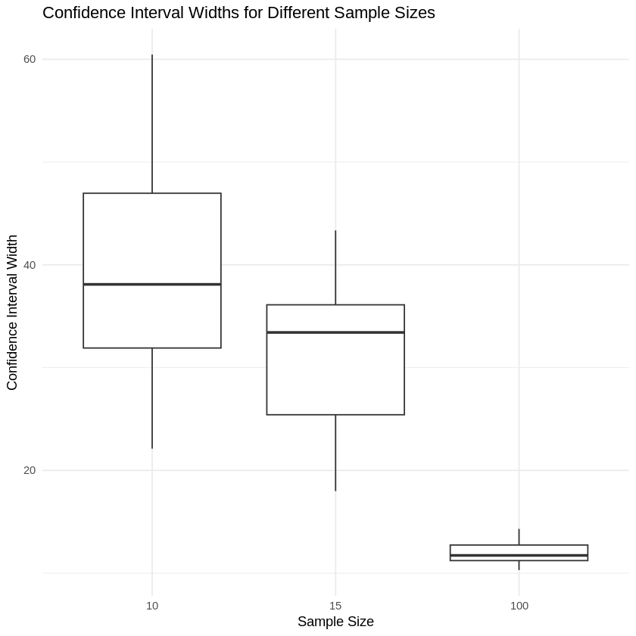
DOES THE WIDTH OF THE CONFIDENCE INTERVALS INCREASE OR DECREASE?
As sample size increases, the confidence interval widths decrease.
46

Slide 47
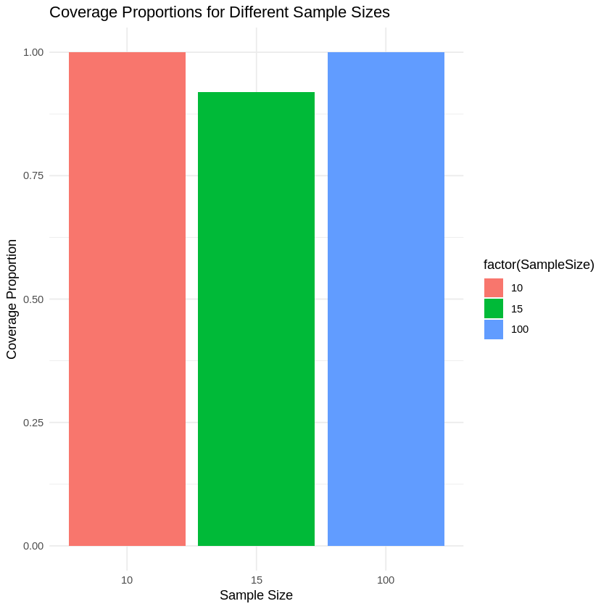
DOES INCREASING THE SAMPLE SIZE RESULT IN MORE OR FEWER INTERVALS CONTAINING THE TRUE POPULATION MEAN?
As sample size increases, the proportion of confidence intervals containing the true population mean increases.
47

